Slide 1

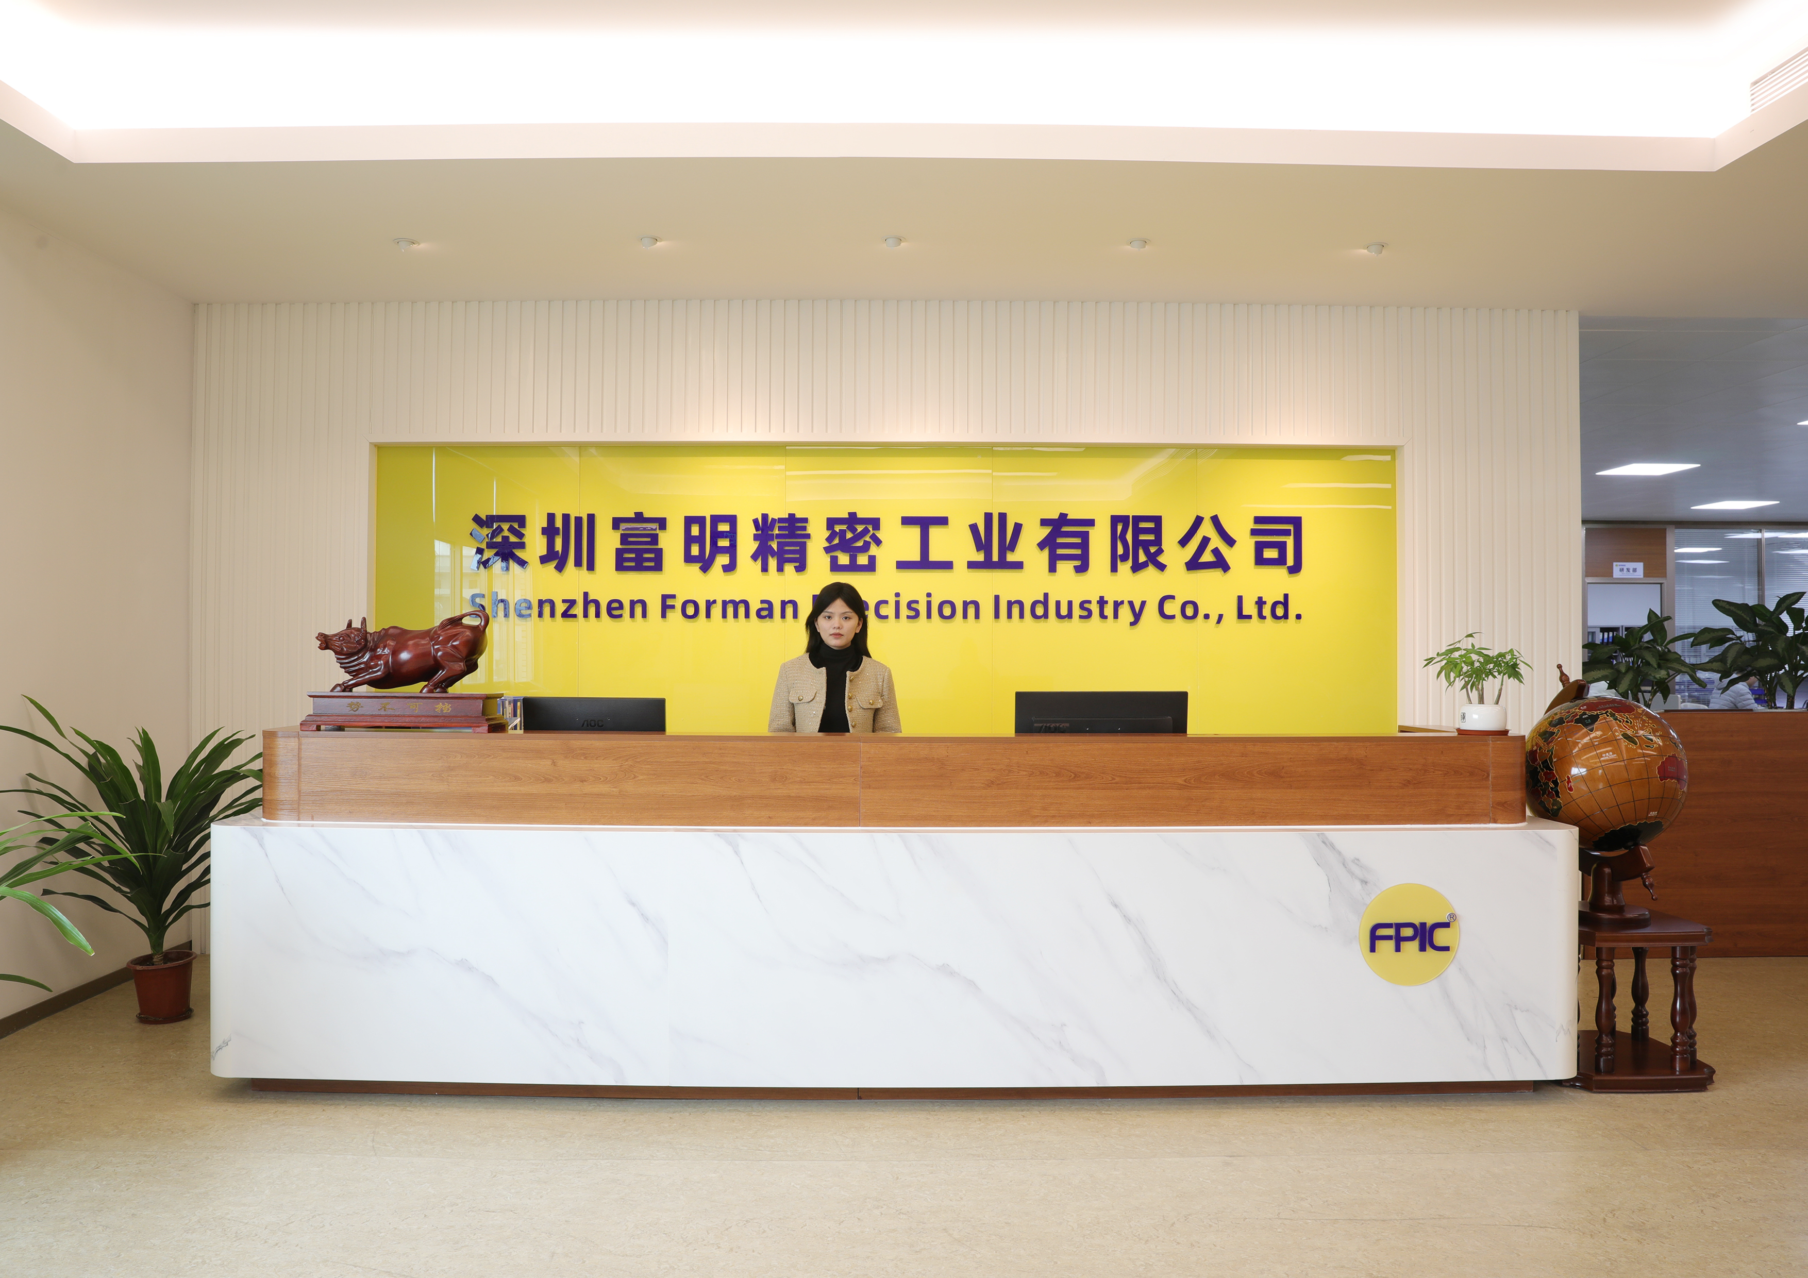
深圳富明精密工业有限公司
Shenzhen Forman Precision Industry Co.,Ltd.
Our Core Value:
Customer-centric,
Contributor-Oriented,
Always try our best!

Slide 2
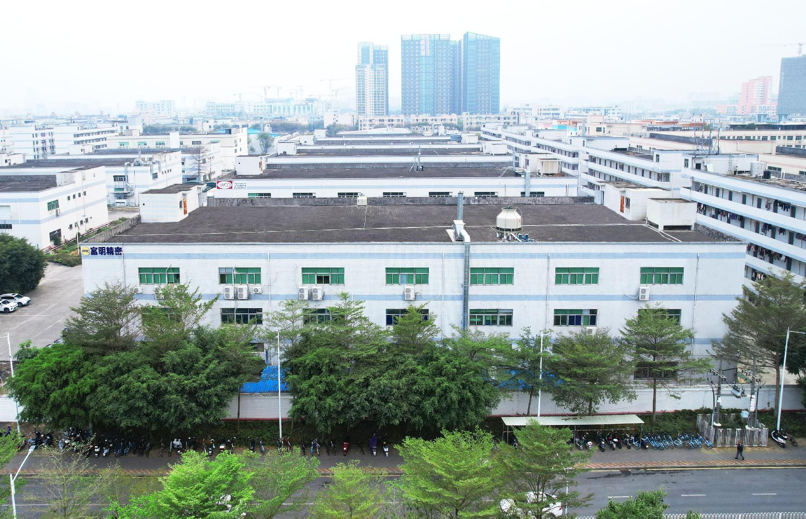
About us
Shenzhen Forman Precision Industry Co., LTD is a leading and experienced manufacturing vendor, dedicated to the development of metal and plastic parts. For over 20 years, we have specialized in the design and production of connectors and cable assemblies. Our market spans the automotive, new energy, industrial automation, and medical devices sectors.
We are certified by ISO 9001, ISO 14001, ISO 45001, IATF 16949, and ISO 13485, and we are also a member of the USB Association, with UL and TUV certifications.
Our goal is to provide a unique service experience and add value for our customers through end-to-end management. We take pride in our reputation for being fast, flexible, and customer-focused.

Slide 3
Our core values
Customer-centric
Understanding and meeting customer need is our company’s duty. We continuously improve our product research and development, manu-facturing processes, and management capabilities to better serve our customers and maintain an unbeatable position in the competition.
Contributor-oriented
Strive to optimize our company’s various management and incentive systems, so that contributors who can better serve customers and continuously improve the company’s capabilities can receive better respect and welfare benefits.
Always try our best
We always try our best to serve every customer anytime.

Slide 4
Company Developments
2003
2004
2006
2013
2016
2023
2024
Today
Foundation
ISO9001
Auto assembly with CCD
ISO14001
IATF16949
UL/TUV
ISO13485
180 employees, 11000 ㎡

Slide 5
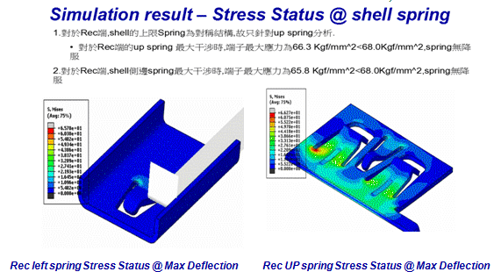
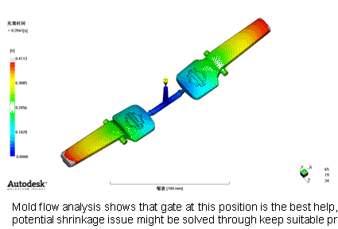
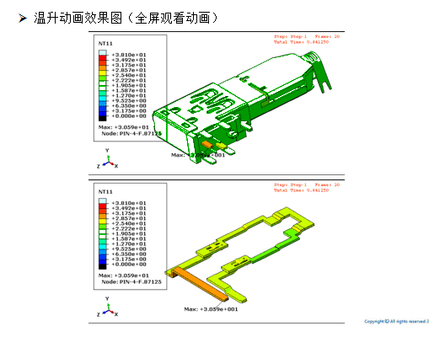
Product Design and Tooling Development
Have 15 production/tooling engineers who have more than 10 years professional experience.
Develop software - PROE, AutoCAD
Process Validation Tool -APQP, PPAP, FMEA, SPC, MSA
Develop Simulating software : Part Design, Tooling Design, Rating Testing
Part Design simulation
Tooling design simulation
Rating test simulation
Mold flow simulation test
Current rating simulation test

Slide 6
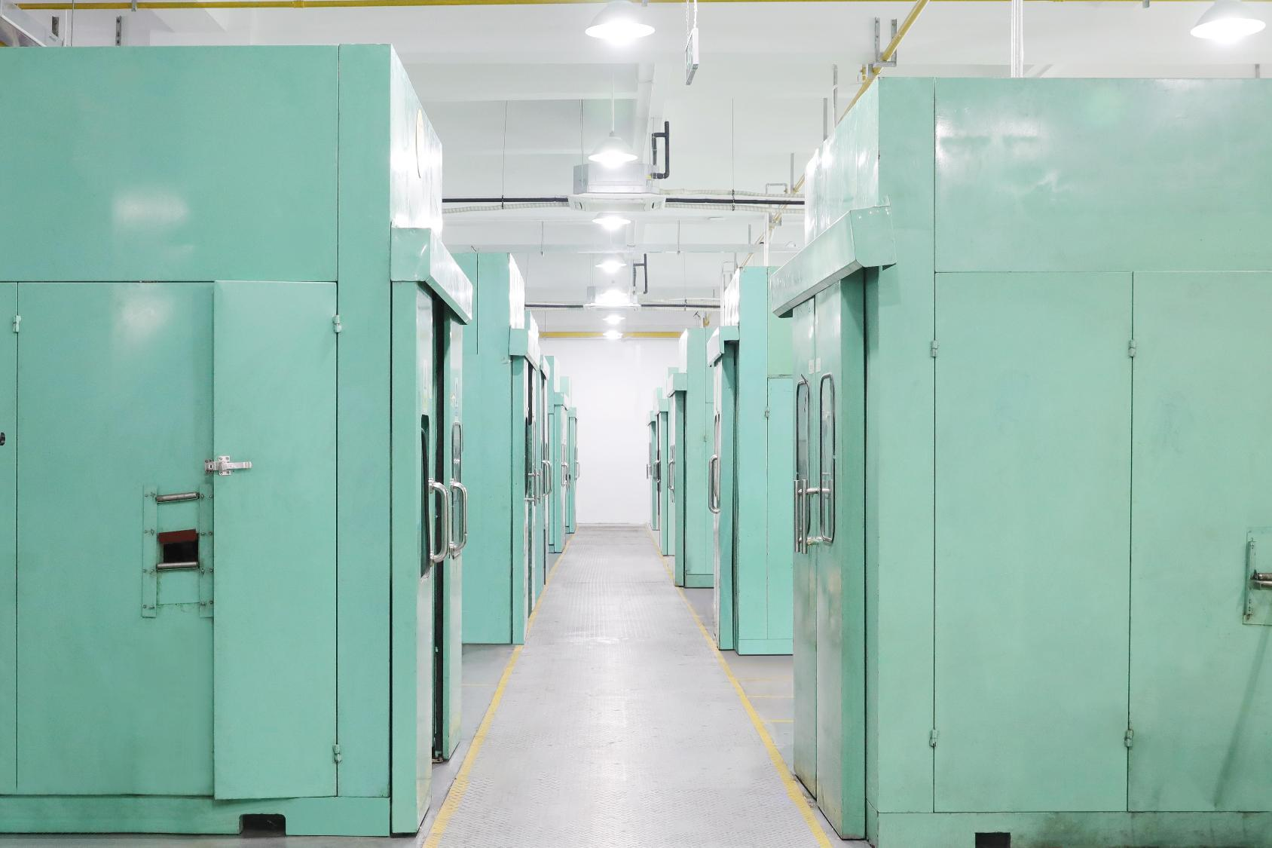
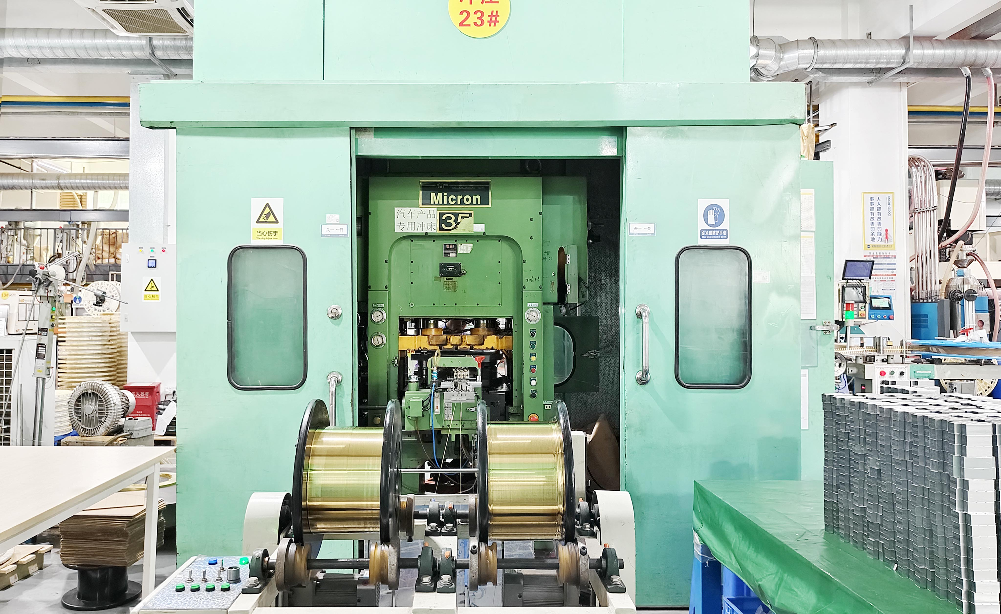
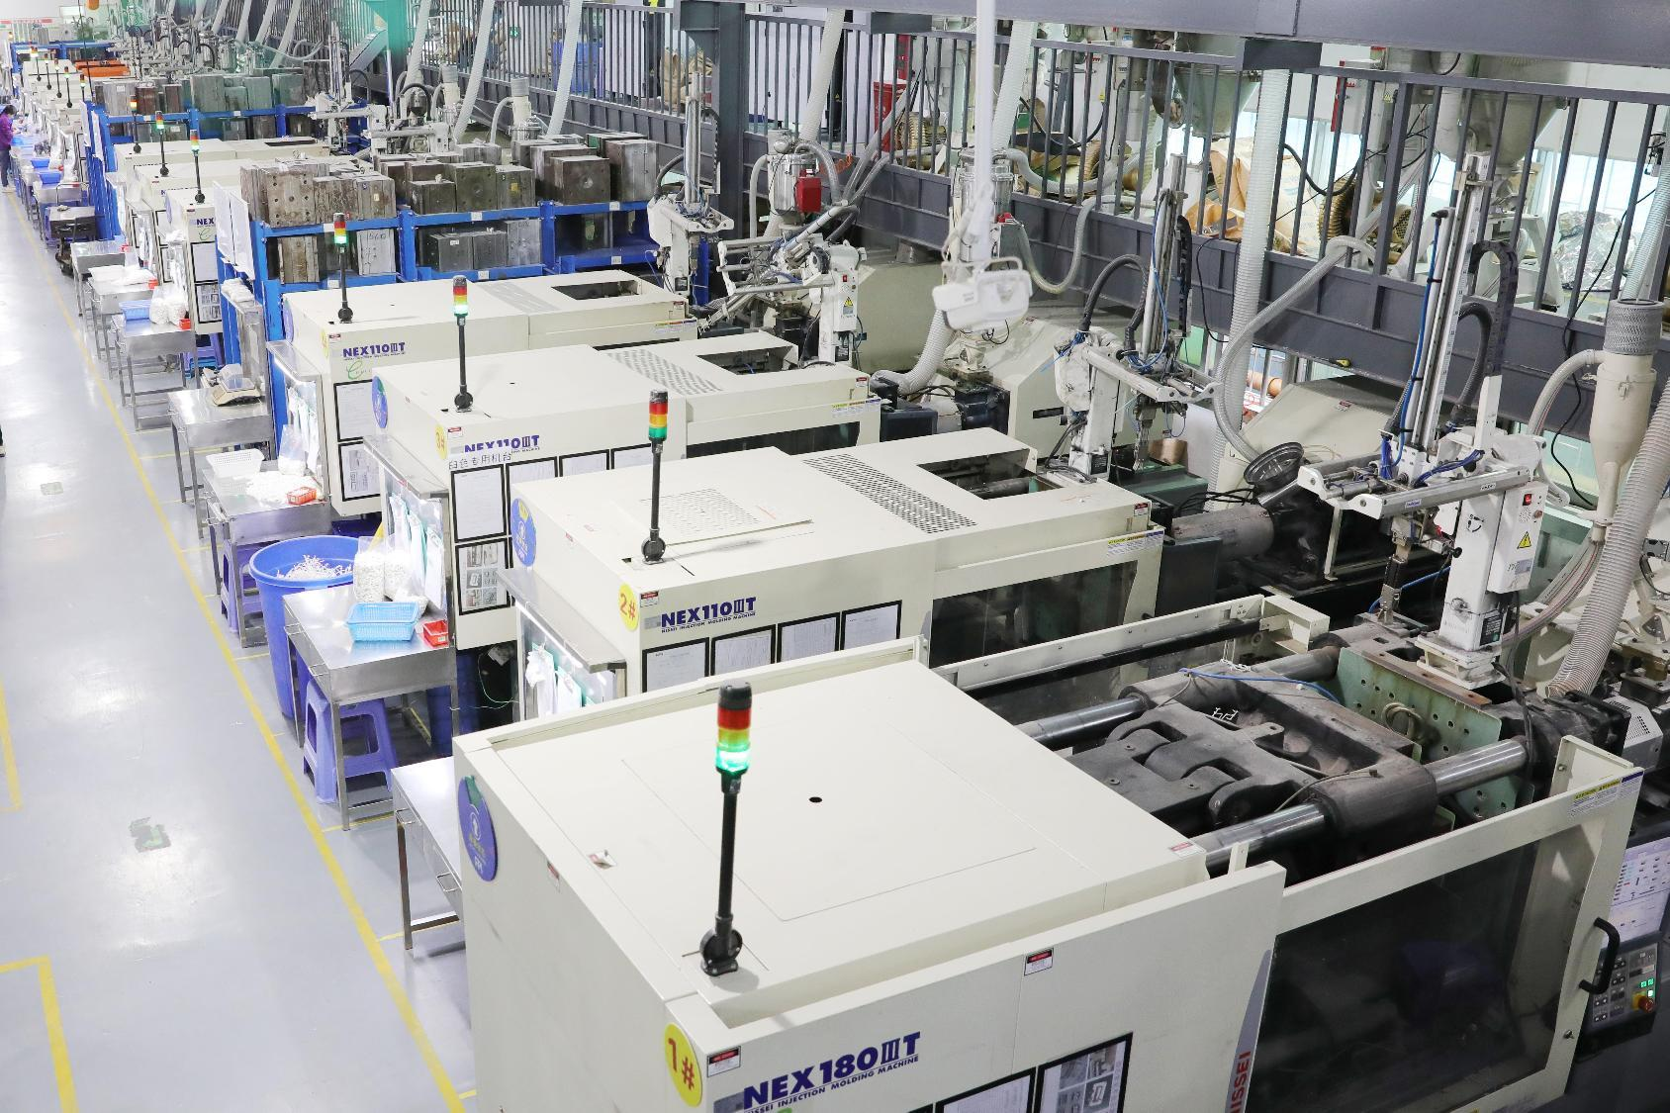
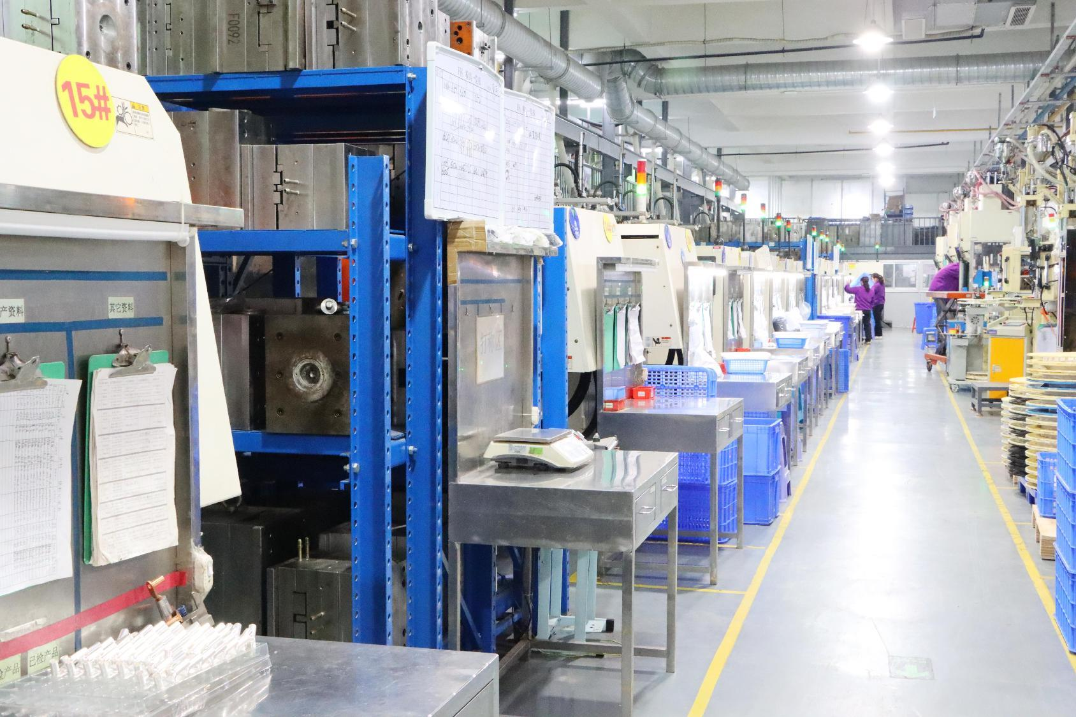
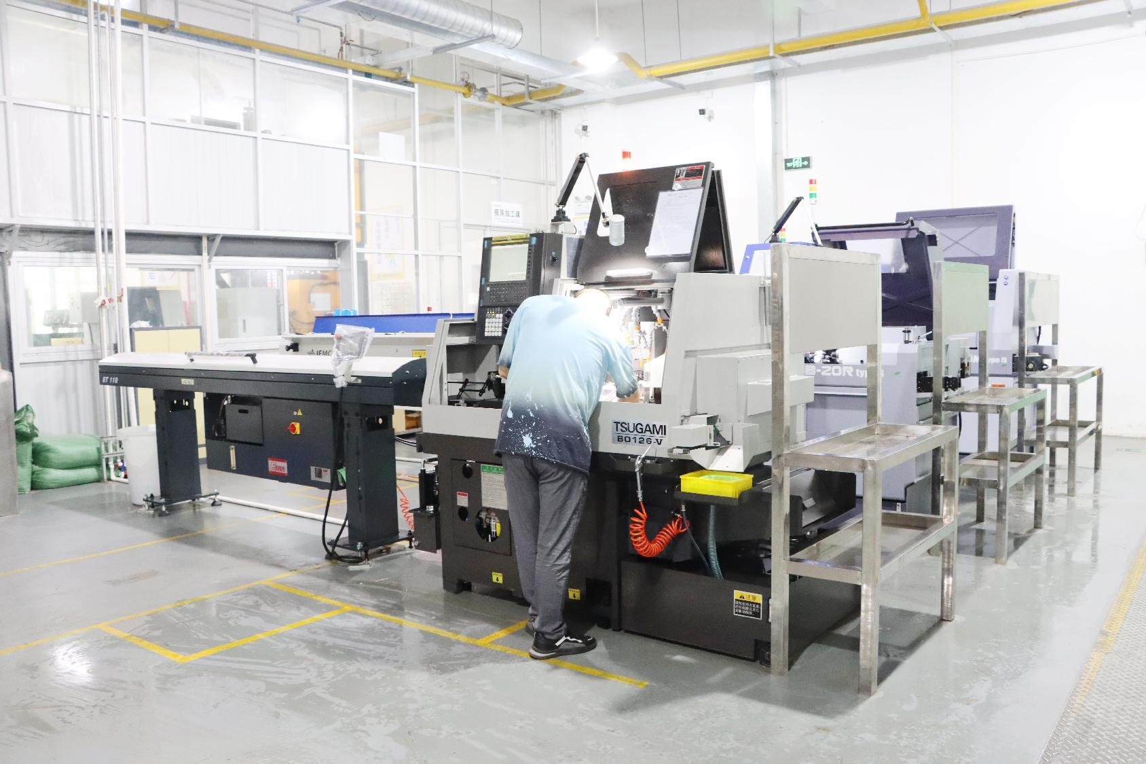
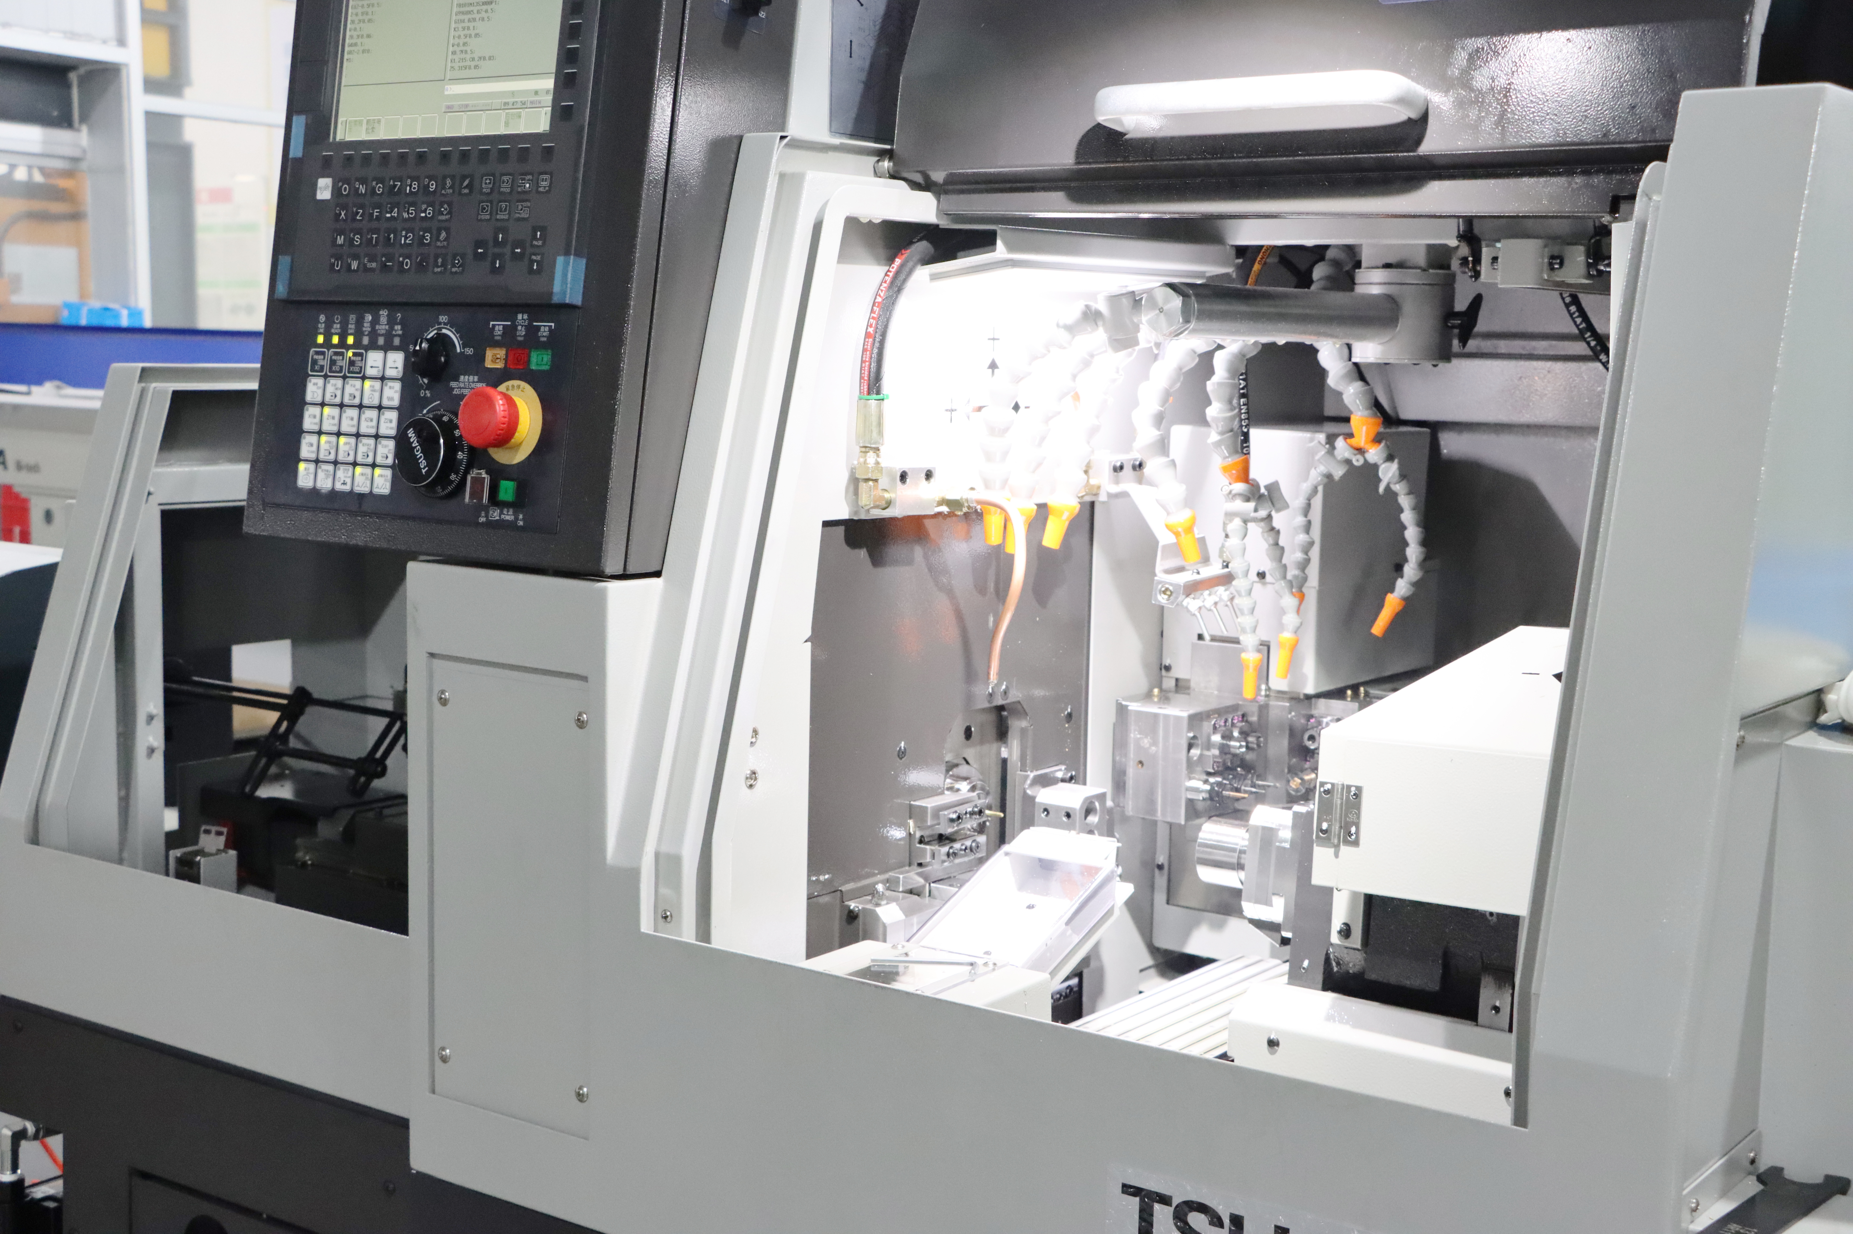
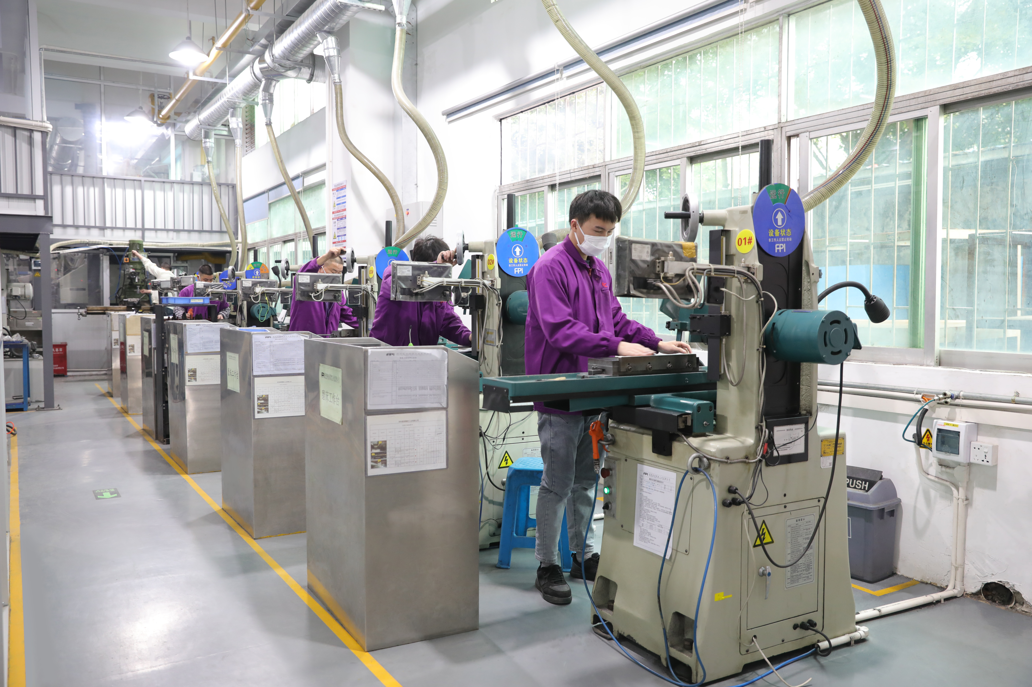
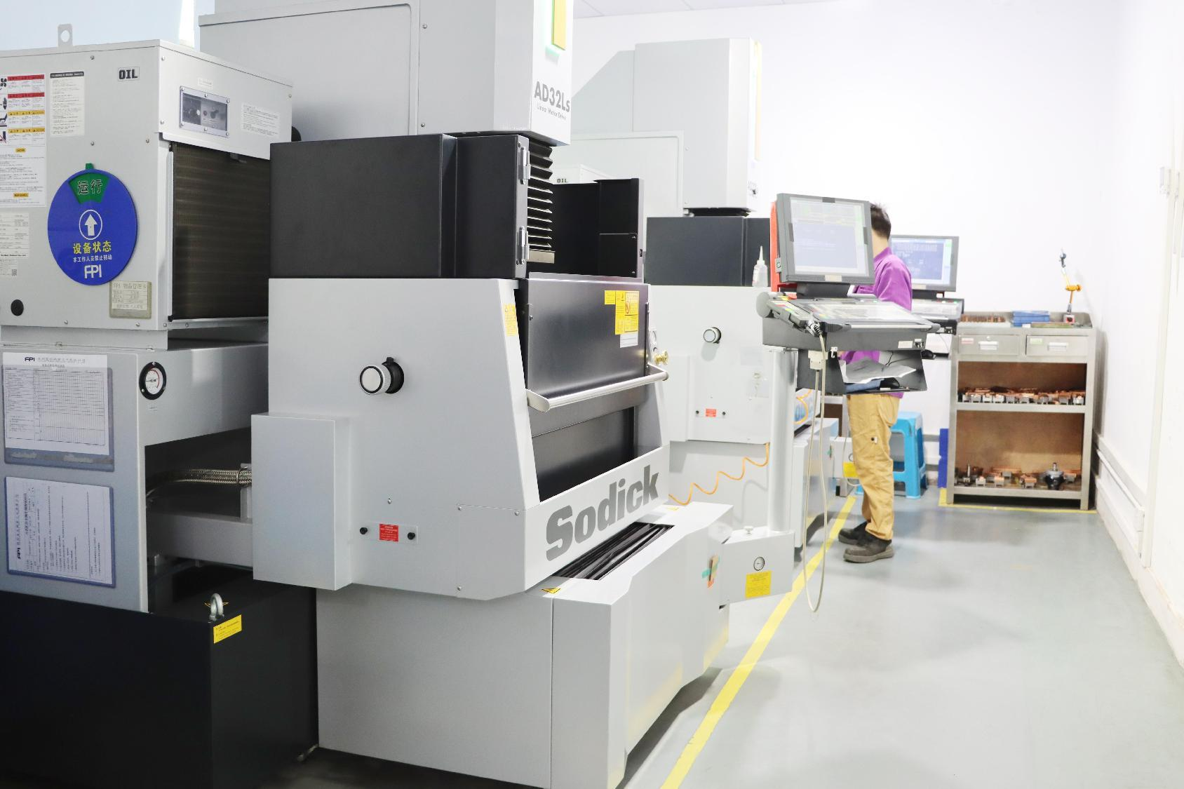
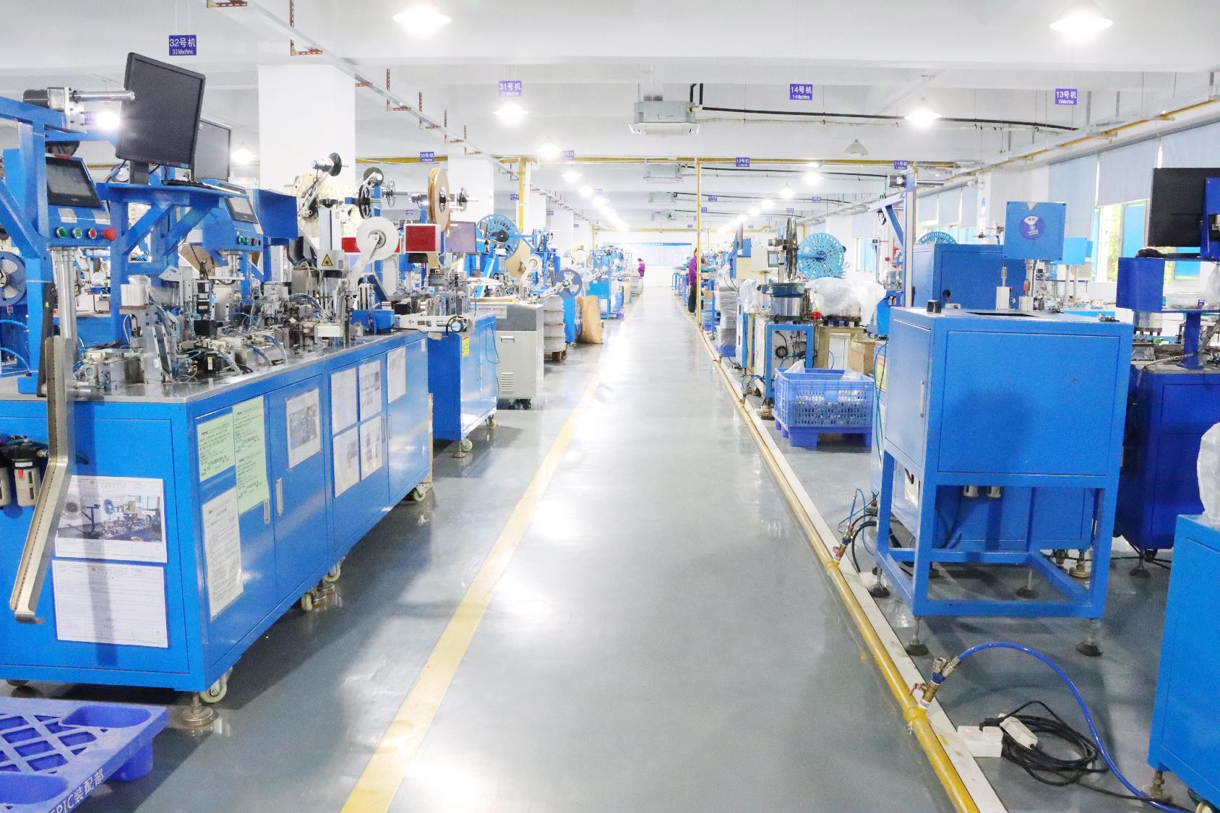
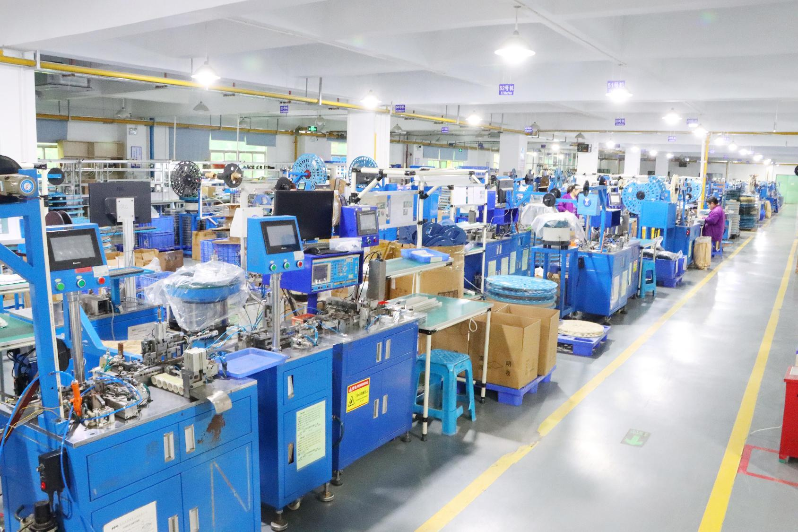
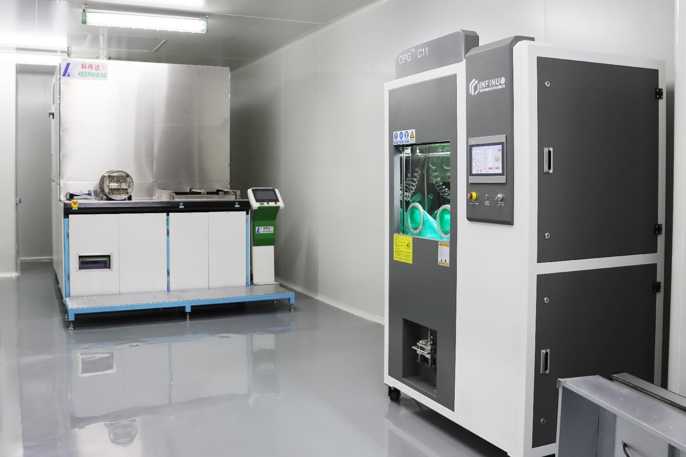
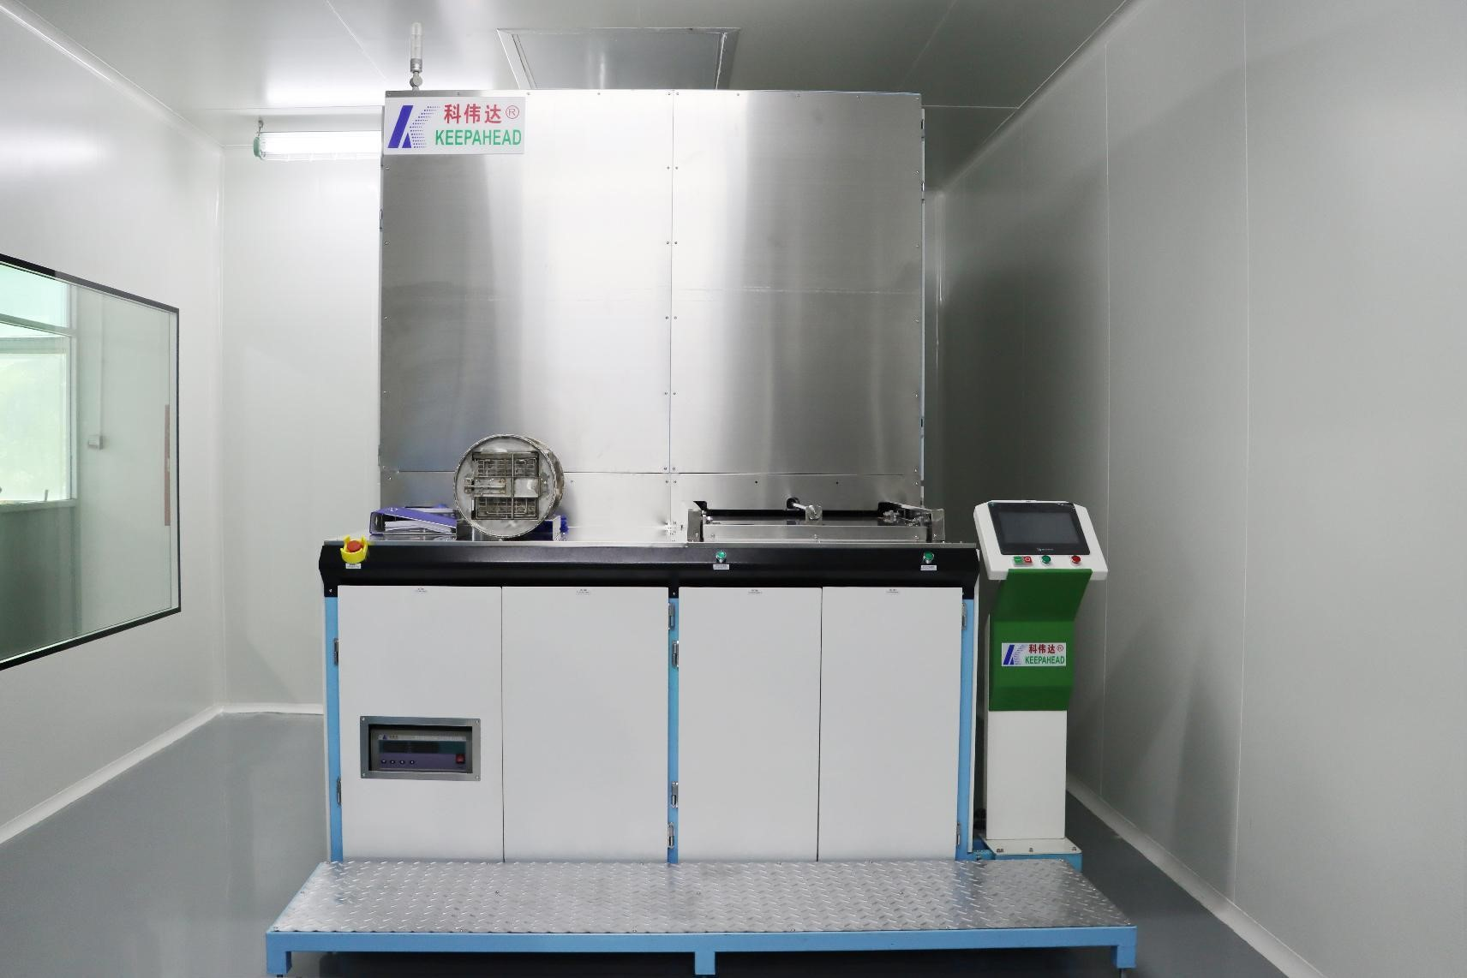
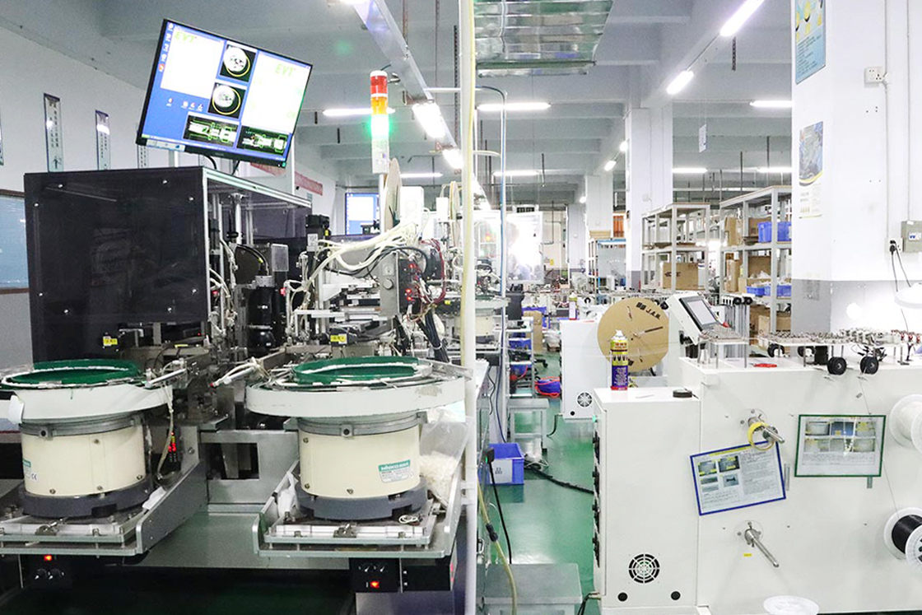
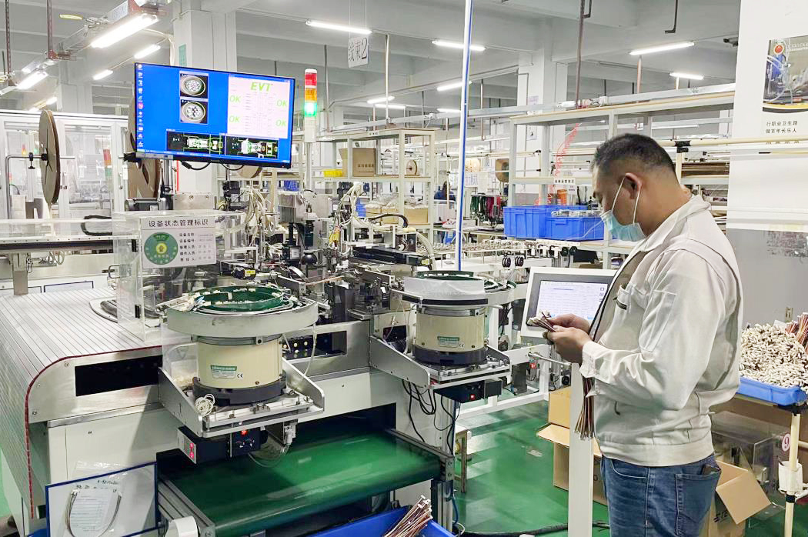
Workshops & Equipments
Stamping Workshop
Plastic Injection Workshop
CNC Workshop
Tooling Machining Workshop
Auto Assembly Workshop（with CCD)
Dust-free Workshop
Wire Harness Workshop

Slide 7
Workshops & Equipments
Equipments List
Exsiting machines of tooling workshop
Name | Model | Brand | QTY | Name | Model | Brand | QTY
WEDM | M50B | SeiBu(Japan) | 1set | Grinder | 614S | HYFAIR(TW) | 11sets
WEDM | AQ560LS/400L | Sodick | 3 sets | Big Grinder | KG-S-306AH | HYFAIR(TW) | 2sets
EDM | M30F | ARD | 3sets | Grinder | JL614 | Zhun Li(TW) | 3sets
Wire Cut | H-CUT 40F | Lian Gao (SZ) | 3 sets | Grinder | JL614 | Yu Qing(TW) | 2sets
Milling machine | 16SS | KUNMING （TW） | 1set
Exsiting machines of injection molding workshop
Name | Model | Brand | QTY | Name | Model | Brand | QTY
Horizontal injection molding machine | 80T-180T | NISSEI/JAPAN | 12 | Vertical injection molding machine | 40T | NISSEI/JAPAN | 3
 | 80T-110T | Zhongtai /(TW) | 5 |  | 55T | Baisu /(TW) | 12
Exsiting machines of metal workshop
Name | Model | Brand | QTY
High-speed Stamping | 40T | YAMADA/JAPAN | 1
High-speed Stamping | 40T | KYORI /JAPAN | 1
High-speed Stamping | 45T~80T | MICRON/(TW) | 15
High-speed Stamping | 80T-200T | SEYI(TW) | 1
CNC SWISS TYPE AUTOMATIC LATHE | SR-32 JM TYPE N | JAPAN | 1
CNC Machine | SB-20R TYPE G | JAPAN | 1
CNC Machine | B0126-V | Tsugami(China) | 1
Four-pin cutting machine | - | - | 1

Slide 8
Workshops & Equipments
Machine List
Exsiting machines of Auto Assembly Workshop
Name | Brand | QTY | Name | Brand | QTY
Automatic Machine with CCD | - | 81 | Plastic Injection Molding Machine | CY-200-4ST103D | 1
Automatic Machine with packing and CCD | - | 1 | Wire winding machine | - | 1
Fully automatic wire stripping and cutting machine | WG-9850 | 1 | Pneumatic Crimping Pliers | - | 1
Servo large square crimping machine | WG-645 | 1 | Pneumatic four-axis crimping tool | YJQ-W2Q | 1
Hexagonal free die for crimping machine | WG-645 | 2 | Soldering Machine |  | 1
Hexagonal mold-free | 17MM | 1 | Silent copper belt machine | WG-1.8T | 1
Computer wire cutting and stripping machine | WG-2004 | 1 | Pneumatic peeling machine | 330 | 1
Computer cutting machine | DPS-100Q | 1 | CNC terminal machine | C3-3.5A | 1
Line Sequence Tester | HRT-N3 | 1 | Servo stripping and terminal crimping machine | C6-2.5S | 1

Slide 9
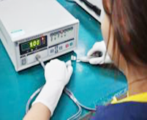
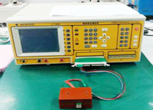
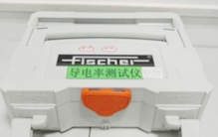
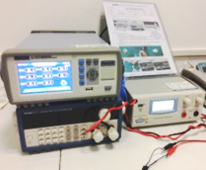
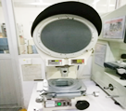
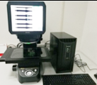
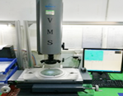
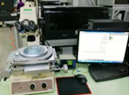
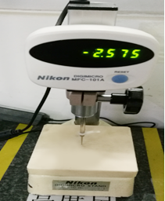
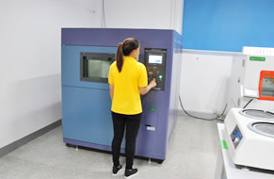
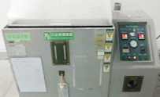
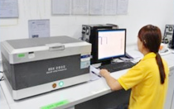
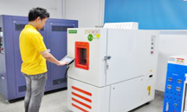
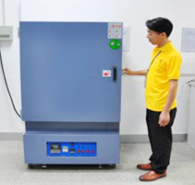
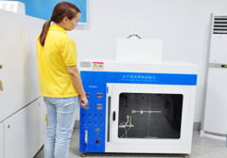
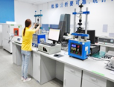
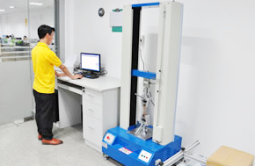
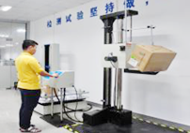
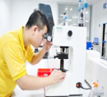
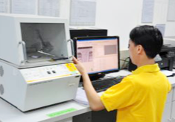
Quality Assurance
Electricity
Major test and measuring instruments
Dimension
Environment
Mechanic

Slide 10
Quality Assurance
Test and measuring equipments list
Purpose | Description | Model | Brand | Qty | Purpose | Description | Model | Brand | Qty
Mechanics | Computer servo system tensile testing machine | XM-SFC0002 | Xiangmin | 1 | Environment | Salt fog Tester | KZ-90A | KeMei | 1
 | Microhardness tester | GHV-1000 | Lianer | 2 |  | Thermal Shock Chamber | S3-08L-A-3 | Sanwood | 1
 | Fluorescence film thickness meter | XULM XYM | Fischer/Germany | 1 |  | Temperature and Humidity Tester | SMC-150-CD | Sanwood | 1
 | Automatic insertion-extractionforce tester | HK-ZBCD-1220 | Hui Tai | 2 |  | XRAY spectrometer (environmentally friendly) | EDX 2800 | Tianrui | 2
 | Insertion-extraction tester | 0-10Kgf | VTV | 5 |  | Horizontal and vertical combustion tester | XM-HV001 | Xiangmin | 1
 | Single wing drop test machine
 |  | XD-DY1500
 |  |  | Xiangmin
 |  |  |  | 1
 |  |  |  |  |  | Three-slot thermal shock test chamber | S3-08L-A-3 | Mitutoyo/Japan | 1
 | Simulated automobile transportation vibration test machine | SM-MNC001 | Xiangmin | 1 |  | High temperature oven | GT-1500DD | Mitutoyo/Japan | 1
 | Density Tester | MH300 | - | 1 |  | Thermometer and Hygrometer | - | Minggao | 8
 |  |  |  |  |  | High cleanliness testing equipment | OPG C11 S | INFINUO | 1
Dimension | KEYENCE one-touch measurement | #7C910390 | Keyence/Japan | 1 | Electricity | Contact impedance tester | HG2511 | Hui Gao | 1
 | microscope | - | - | 1 |  | Temperature rise Tester | SJ-10X/8511A | SUNJaT | 6
 | Nikon Projector | MFC-101A | Nikon/Japan | 1 |  | Cable harness tester | CT-8681 | Yihe | 42
 | Nikon Height Gauge | - | Nikon/Japan | 1 |  | Conductivity Tester | SMP350 | Fischer/Germany | 1
 | Height gauge | - | Mitutoyo/Japan | 7 |  | Withstand voltage insulation tester | 71CM230528006 | REK | 6
 | Second dimension tester | VMS-2010G | Wanhao | 8 |  | Anti-static Tester | 385胜利 | - | 1
 | Projector | CPJ-3015Z | Wanhao | 2 | Special Test | X-RAY Fluoroscope | 1000 | Unicomp | 1

Slide 11
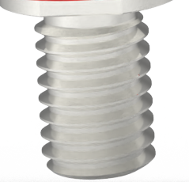
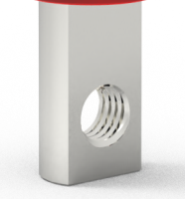
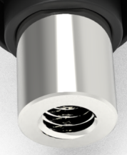
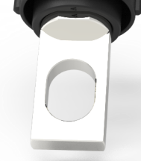
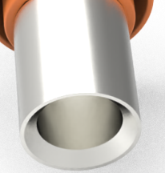
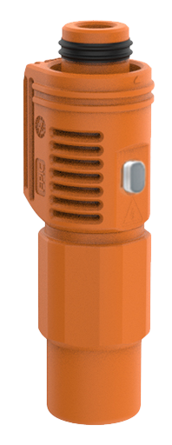
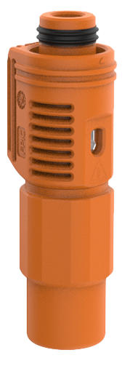
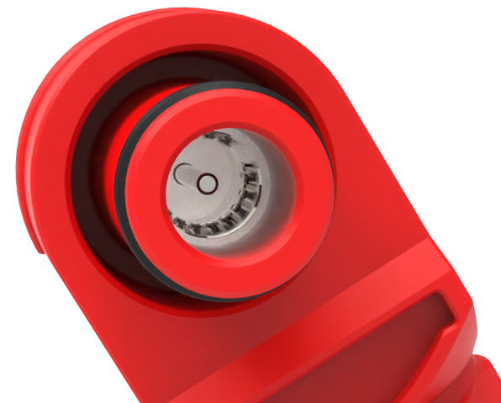
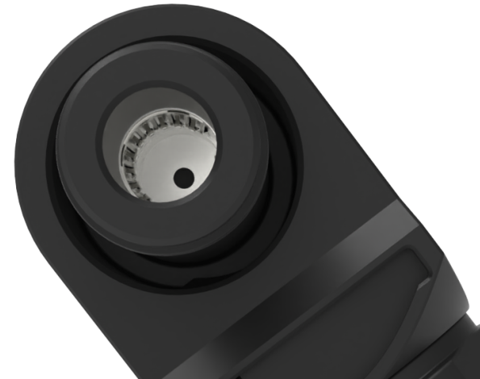
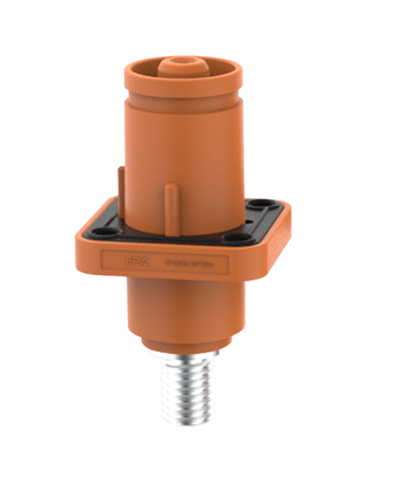
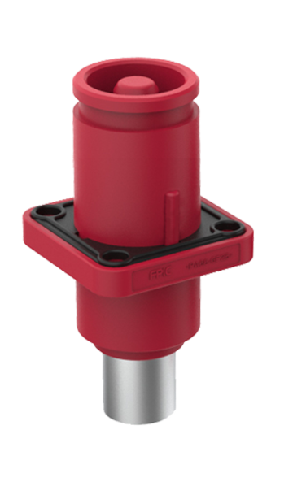



Our Products
Key Features:
Touch proof, safety, reliability
360° rotating plug, conserve space, operational
efficiencies
UL 4128 standard
IP67 waterproof
Different installation key on receptacles
Energy storage connectors & cables
Outer Thread
Copper Bar Inner Thread
Inner Thread
Copper Bar Thourgh Hole
Crimping
360°
360° Rotating
Press to release
Different installation key on pole and color
Tool unlock
Manually unlock
Different keying pisitions
Five connection method on each Pole and color
Touch proof
Installation key

Slide 12






Our Products
E-Bike Connectors & Cables
Features:
Easy and quick installation, safe and reliable
Ergonomic and aesthetically pleasing
Customizable cable length

Slide 13






Our Products
Electric Vehicle HV Connectors & Cables

Slide 14






Our Products
Automotive connectors
Features:
IATF16949 Certified
Mass production of products compliant with VDA 19.1 (ISO 16232-10)
Tier-2 Supplier of BMW, VW, PORSCHE, RENAULT, FORD,etc.
Experienced in Rapid Prototyping & Mass Production

Slide 15









Our Products
Circular connectors & cables
Features:
Mechanical life: 500 cycles
strong vibration resistance
IP67 waterproof
360-degree shielding
Temperature resistance: -40 to 105°C

Slide 16



Our Products
Push-pull Self-locking Connectors
Features:
1,000-hour salt spray resistance
Insertion and extraction cycle >5000 times
-55°C to 250°C operating temperatures
Fluid Connectors
Features:
Push-Pull Locking Mechanism
1000-hour salt spray resistance
Insertion and extraction cycle >5,000 times
Indoor/protected
environments (IP50)
Compact Design
10U”thick gold plating
Push-Pull self
latching system
Multi-Keying system
Up to 64 contacts

Slide 17








Our Products
Industrial Wire Harness

Slide 18







Our Products
Medical Wire Harness

Slide 19


Our Products
PCBA connectors

Slide 20















Our Products
Metal parts
Composite Terminals
Spring-Clip Terminals--Automotive Standard
Terminal
Press Fit Terminals
Spring-Clip Terminals
Shielding Covers
Automotive Terminal
Automotive Clip
Stamped Fins
Folded Fins
CNC Machined Parts
CNC Machined Parts
CNC Machined Parts
CNC Machined Parts

Slide 21





Our Products
Insert Molding Parts

Slide 22

......
SRM
ERP
APS
Our Platforms
WMS
Intelligent manufacturing operration management platform
PLM
MES
QMS
SCADA
OA
BI
CRM

Slide 23






Certificates
Meet the Safety Standard of Management System
IATF16949
ISO9001
ISO13485
ISO14001
TUV Verified
UL Verified

Slide 24











Our Customers
Europe
North America
Asia
Shenzhen
Africa
South America
Australia

Slide 25
Our Strengths
Focusing on the connector and wire harness industry for over 20 years, we are able tvo provide you with more professional service in this industry.
We offer end-to-end solutions, including product design, mold design and manufacturing, parts production, automated assembly, testing, and packaging for connectors, wire harnesses, and metal parts.
The positioning of a small and beautiful enterprise can provide you high quality(vendor of several top brands in the industry), reasonably priced products, and quick response during the service process.
Zero risk of development promise: we’ll refund all development costs to customer, if our company’s development work can’t meet their requirement.

Slide 26

Welcome to visit us!
Shenzhen Forman Precision Industry Co., Ltd.
Building K, No. 2, Longshan Eighth Road, Luotian Community,Yanluo Street, Baoan District, Shenzhen City, GD, China.

