Slide 1
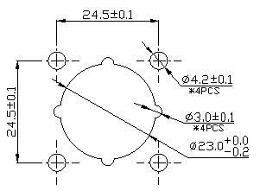
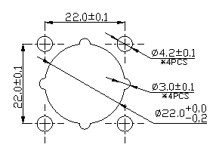
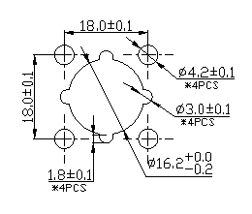
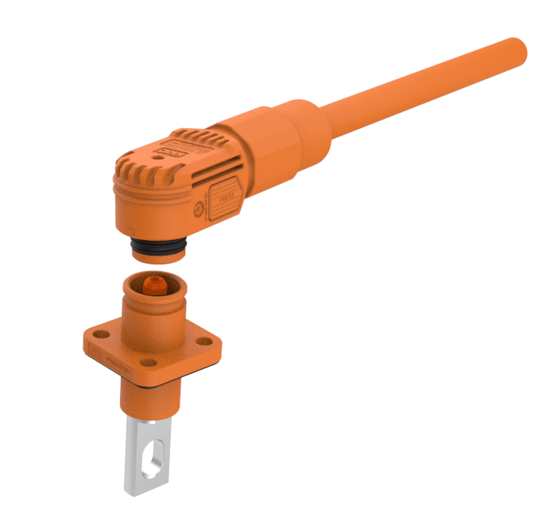
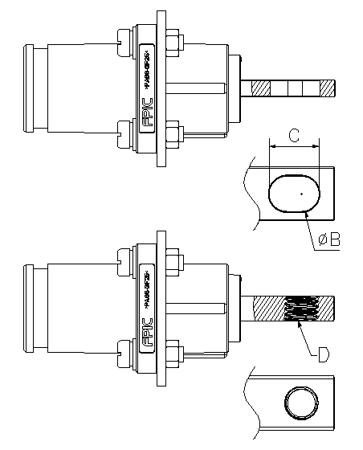
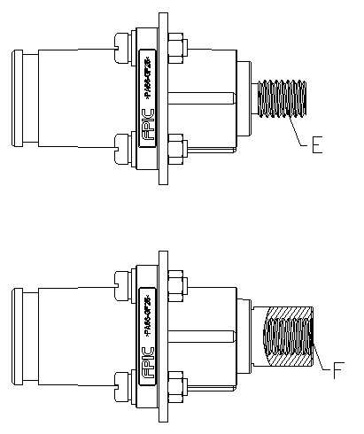
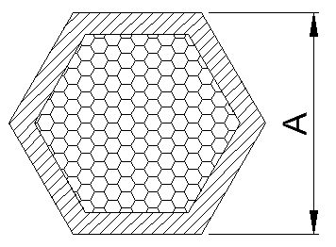
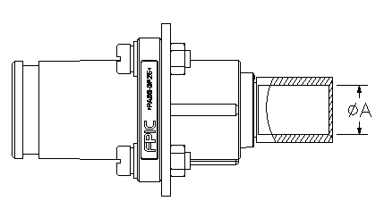
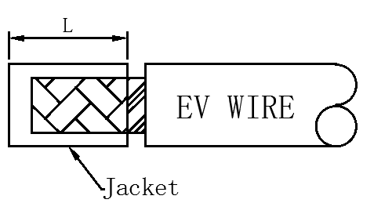
RECEPTACLE CONNECTOR
PLUG CONNECTOR
1. Hole size of mounting panel.
1.Cut Cable off outer jacket:
CONNECTOR ASSEMBLY
Push
ES 1000V/1500V
8.0 SERIES
2. Mount connector fittings on both ends in turn :
ES 1500V 10.0 SERIES
ES 1000V 6.0 SERIES
2. Receptacle Assembly :
Click
RECEPTACLE CONNECTOR
The socket is assembled on the mounting panel with M4 standard screws and the torque is 0.7 N * m
3.Socket classification:
Insulation bushing
Cable seal
Cable Nut
Assembly OK
3. Connector crimping:
HISTORIES AND REVISIONS
Pull out
COPPER BUS
THROUGH HOLE
OUTER SCREW
Pull out
The measurement
diagram
4.Connector Mating
CRIMPING
COPPER BUS
THREAD HOLE
INNER SCREW
Press button
Key dimensions of sockets:
ES series | Size ΦA | Size ΦB | Size C | Size D | Size E | Size F
ES 1000V 6.0 | 7.5 | 6.5 | 10 | M6*1.0 | M6*1.0 | M6*1.0
ES 1000V 8.0 | 10.6 | 8.5 | 12 | M8*1.25 | M8*1.25 | M8*1.25
ES 1500V 8.0 | 10.6 | 8.5 | 12 | M8*1.25 | M8*1.25 | M8*1.25
ES 1500V 10.0 | 12.6 | 8.3 | 13.3 | M10*1.5 | M10*1.5 | M10*1.5
Battery Pin connector
The plug connector can only be used with the corresponding series of sockets, and the device plug can only be used indoors.
4. Crimping socket processing size reference:
5.Plug assembly data sheet:
WARNING:Risk of burns
The connector heats up during operation.It can heat up to 125℃,depending on the ambient conditions. In this case, the user is responsible for attaching warnings(e.g.,in accordance with DIN EN ISO 13732-1).
IES series | Connector P/N | Cable spec | Cable OD (mm) | Cable Strip L(mm) | Tool width W(mm) | Crimp height A(mm) | Pull-out force(N)
ES 1000V 6.0 | A082-1F06-C010N-XX-XX | 10mm² | 6.4±0.3 | 12±1 | 8.0 | 6.2±0.1 | ≥900N
 | A082-1F06-C016N-XX-XX | 16mm² | 10.2±0.3 | 12±1 | 8.0 | 7.0±0.1 | ≥1500N
 | A082-1F06-C025N-XX-XX | 25mm² | 10.0±0.3 | 12±1 | 8.0 | 7.4±0.1 | ≥1900N
ES 1000V 8.0 | A081-1F08-C025N-XX-XX | 25mm² | 10.0±0.3 | 18±1 | 12.0 | 7.4±0.1 | ≥1900N
 | A081-1F08-C035N-XX-XX | 35mm² | 11.0±0.4 | 18±1 | 12.0 | 8.8±0.1 | ≥2300N
 | A081-1F08-C050N-XX-XX | 50mm² | 13.0±0.5 | 18±1 | 12.0 | 10.4±0.1 | ≥2800N
ES 1500V 8.0 | A083-1F08-C025N-XX-XX | 25mm² | 10.0±0.3 | 16±1 | 12.0 | 7.4±0.1 | ≥1900N
 | A083-1F08-C035N-XX-XX | 35mm² | 11.0±0.4 | 16±1 | 12.0 | 8.8±0.1 | ≥2300N
 | A083-1F08-C050N-XX-XX | 50mm² | 13.0±0.5 | 16±1 | 12.0 | 10.4±0.1 | ≥2800N
ES 1500V 10.0 | A083-1F10-C035N-XX-XX | 35mm² | 11.0±0.4 | 19±1 | 15.0 | 8.8±0.1 | ≥2300N
 | A083-1F10-C050N-XX-XX | 50mm² | 13.0±0.5 | 19±1 | 15.0 | 10.4±0.1 | ≥2800N
 | A083-1F10-C070N-XX-XX | 70mm² | 15.0±0.5 | 19±1 | 15.0 | 12.4±0.1 | ≥3500N
The measurement
diagram
IES series | Connector P/N | Cable spec | Cable Strip L(mm) | Tool width W(mm) | Crimp height A(mm) | Pull-out force(N)
ES 1000V 6.0 | A082-2M06-C025B-XX-XX | 25mm² | 12±1 | 8.0 | 7.4±0.1 | ≥1900N
 | A082-2M06-C025F-XX-XX | 25mm² | 12±1 | 8.0 | 7.4±0.1 | ≥1900N
ES 1000V 8.0 | A081-2M08-C050B-XX-XX | 50mm² | 18±1 | 12.0 | 10.4±0.1 | ≥2800N
 | A081-2M08-C050F-XX-XX | 50mm² | 18±1 | 12.0 | 10.4±0.1 | ≥2800N
ES 1500V 8.0 | A083-2M08-C050B-XX-XX | 50mm² | 16±1 | 12.0 | 10.4±0.1 | ≥2800N
 | A083-2M08-C050F-XX-XX | 50mm² | 16±1 | 12.0 | 10.4±0.1 | ≥2800N
ES 1500V 10.0 | A083-2M10-C070B-XX-XX | 70mm² | 18±1 | 12.0 | 12.4±0.1 | ≥3500N
 | A083-2M10-C070F-XX-XX | 70mm² | 18±1 | 12.0 | 12.4±0.1 | ≥3500N
1.Safety notes
Only electrically qualified personnel may install and operate the product.
Do not disconnect the connectors under load.
Always connect only “+” to “+”and “-” -“”.
2.Suitable conductor
-Multi-wire flexible copper conductor,class 6 in accordance with IEC 60228
-Outer diameter 6.4 to 15.0mm
Select the appropriate seal for your diameter.

